Slide 1
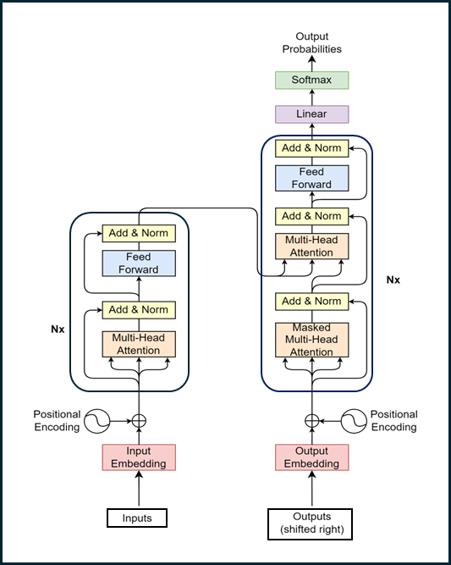
Part 2 – Introduction to Transformer
Quang Duong

Slide 2
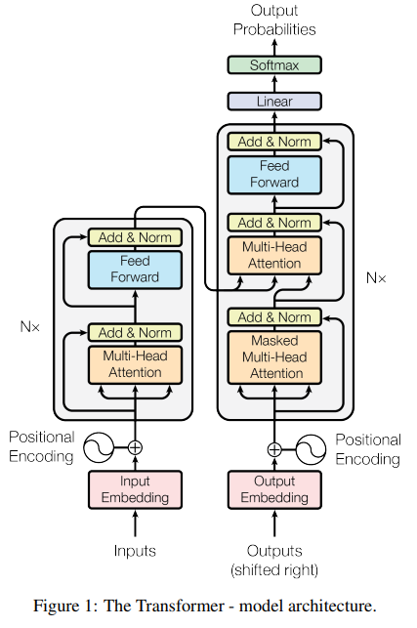
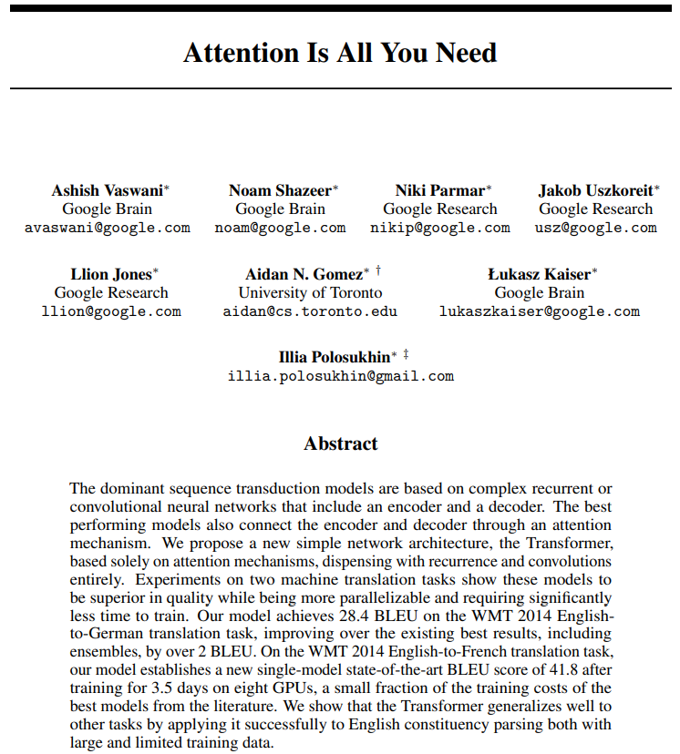
Transformer
Attention Is All You Need, A. Vaswani et al, 2017, https://arxiv.org/abs/1706.03762

Slide 3
NLP until 2017
Recurrent Neural Networks (RNNs)
Long Short-Term Memory (LSTM) networks
Gated Recurrent Units (GRU)
2017

Slide 4
NLP until 2017
Recurrent Neural Networks (RNNs)
Long Short-Term Memory (LSTM) networks
Gated Recurrent Units (GRU)
2017
Some advantages of RNNs (among others)
Efficient handling of sequential data types such as text, speech, and time series.
Ability to process inputs of variable lengths, a feature lacking in feedforward neural networks.
Enhanced training efficiency due to weight sharing across different time steps.

Slide 5
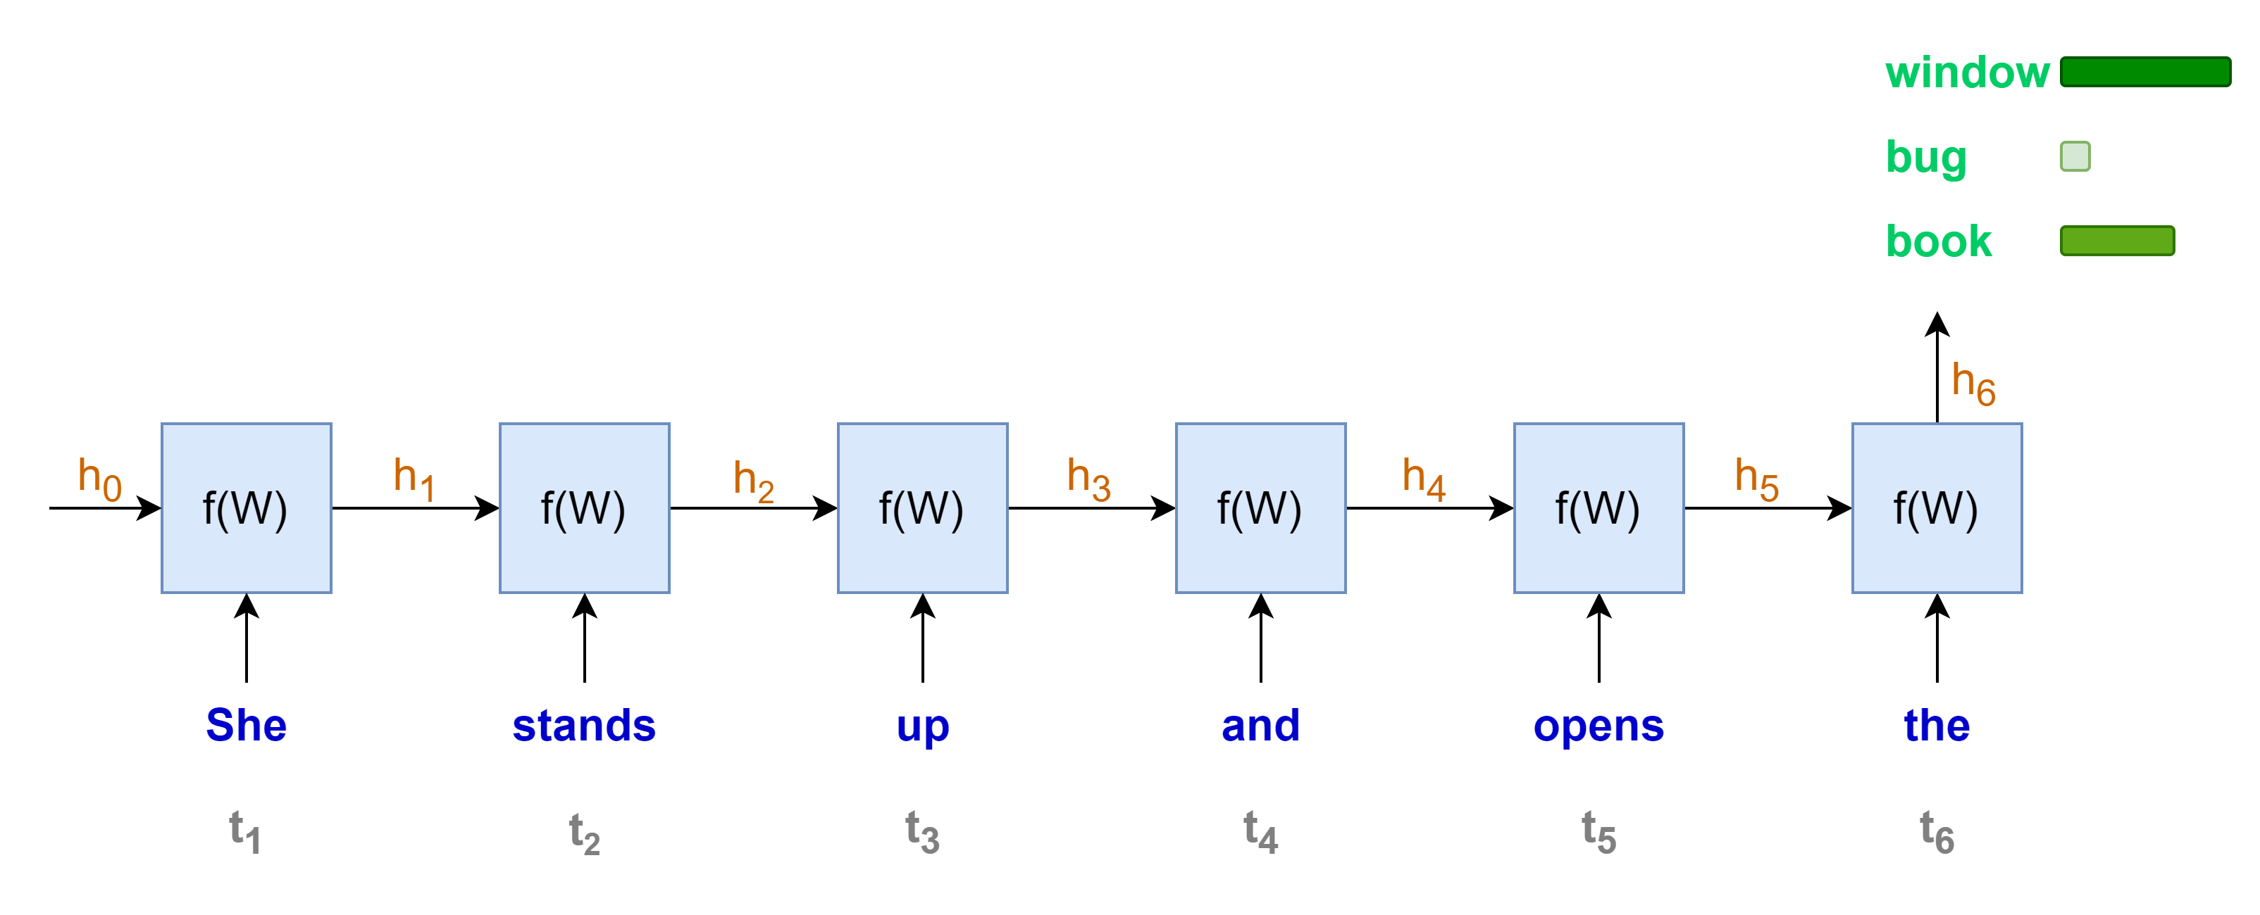
Language modeling with RNNs
“She stands up and opens the …”
Some disadvantages of RNNs (among others)
Sequential computation, one word at a time
→ Less rooms for parallel computation
→ Longer sequence, longer computation time

Slide 6
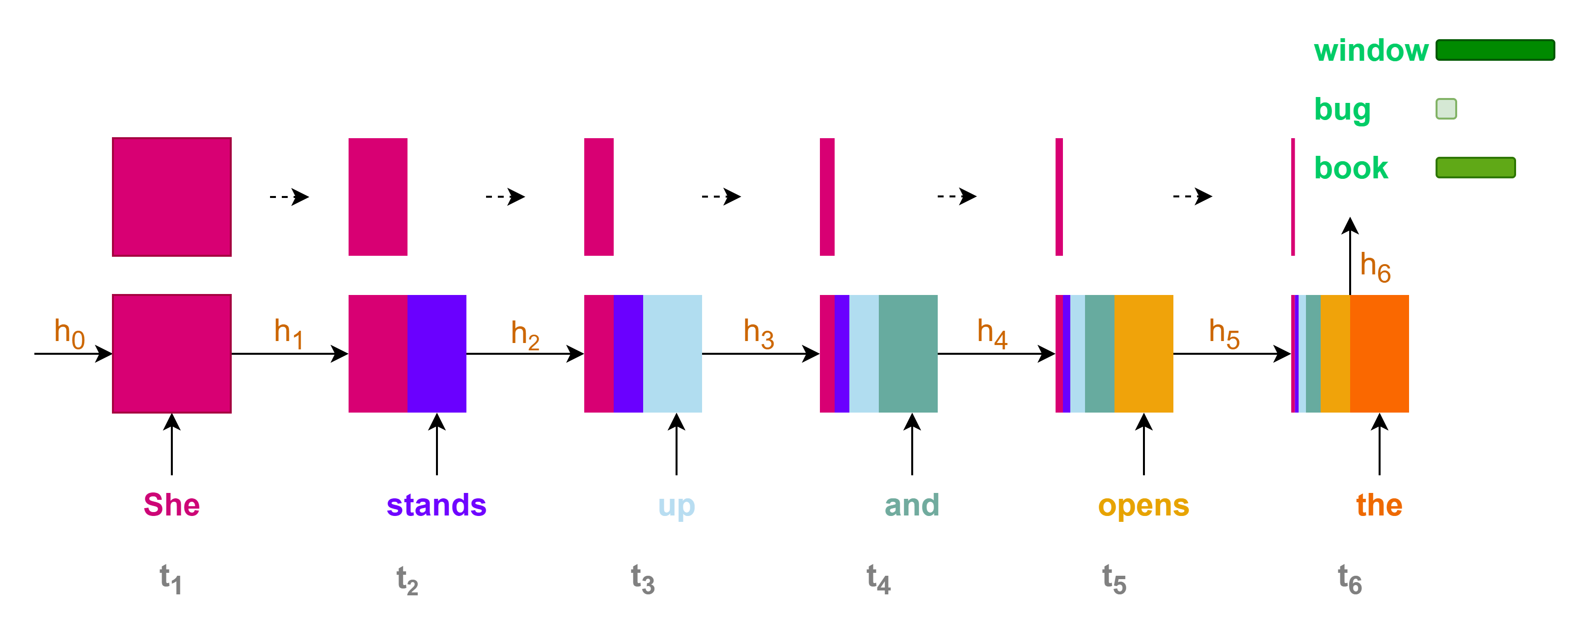
Language modeling with RNNs
Some disadvantages of RNNs (among others)
Contributions of initial states or information to the final state or prediction are very small for long sequence context
→ Loss of information for long-range dependencies

Slide 7
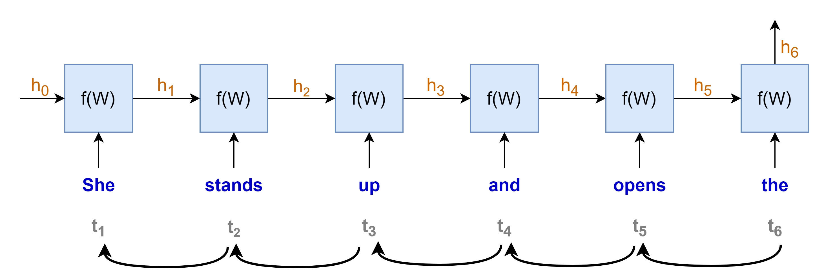
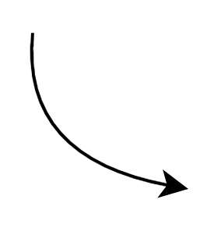
















Language modeling with RNNs
$$gradient products$$
$$\frac{∂h_{t}}{∂h_{t−1}}≪1 →very small→"vanished"$$
$$\frac{∂h_{t}}{∂h_{t−1}}≫1 →very large→"exploded"$$
$$\frac{∂h_{1}}{∂W}$$
$$\frac{∂h_{2}}{∂h_{1}}$$
$$\frac{∂h_{3}}{∂h_{2}}$$
$$\frac{∂h_{4}}{∂h_{3}}$$
$$\frac{∂h_{5}}{∂h_{4}}$$
$$\frac{∂h_{6}}{∂h_{5}}$$
$$×$$
$$×$$
$$×$$
$$×$$
$$×$$
$$\frac{∂L}{∂W}=\frac{∂L}{∂y}\frac{∂y}{∂h_{6}}$$
$$×$$
“chain rule”
Some disadvantages of RNNs (among others)
Training with Backpropagation Through Time
Vanishing or exploding gradients problems
hindering the learning process, especially for long sequences
making the training process highly unstable

Slide 8
NLP until 2017
Recurrent Neural Networks (RNNs)
Long Short-Term Memory (LSTM) networks
Gated Recurrent Units (GRU)
2017
Some disadvantages of RNNs (among others)
Sequential computation, hard to parallel computation with GPU
Loss of information for long-term dependencies
Vanishing or exploding gradient problems

Slide 9
The arrival of Transformer
2017
Recurrent Neural Networks (RNNs)
Long Short-Term Memory (LSTM) networks
Gated Recurrent Units (GRU)
Transformer
"Attention Is All You Need"

Slide 10


Transformer for machine translation
Prediction:
"Je vais bien"
Transformer
Decoder
Encoder
Source:
"I am fine"
Simplified transformer architecture

Slide 11
The arrival of Transformer
2017
Recurrent Neural Networks (RNNs)
Long Short-Term Memory (LSTM) networks
Gated Recurrent Units (GRU)
Transformer
Some disadvantages of RNN
(among others)
Sequential computation, hard to parallel computation with GPU
Loss of information for long-term dependencies
Vanishing or exploding gradient problems
Transformer with self-attention mechanism
(among others)
Parallel computation → leverage GPU
Capture long-range dependencies
Less prone to vanishing or exploding gradient

Slide 12
NLP revolutions since 2017
2017
2018
Recurrent Neural Networks (RNNs)
Long Short-Term Memory (LSTM) networks
Gated Recurrent Units (GRU)
Transformer
Pre-trained language models
BERT
GPT
T5
PaLM
Llama
Mistral
Phi
Falcon
OLMo
…

Slide 14
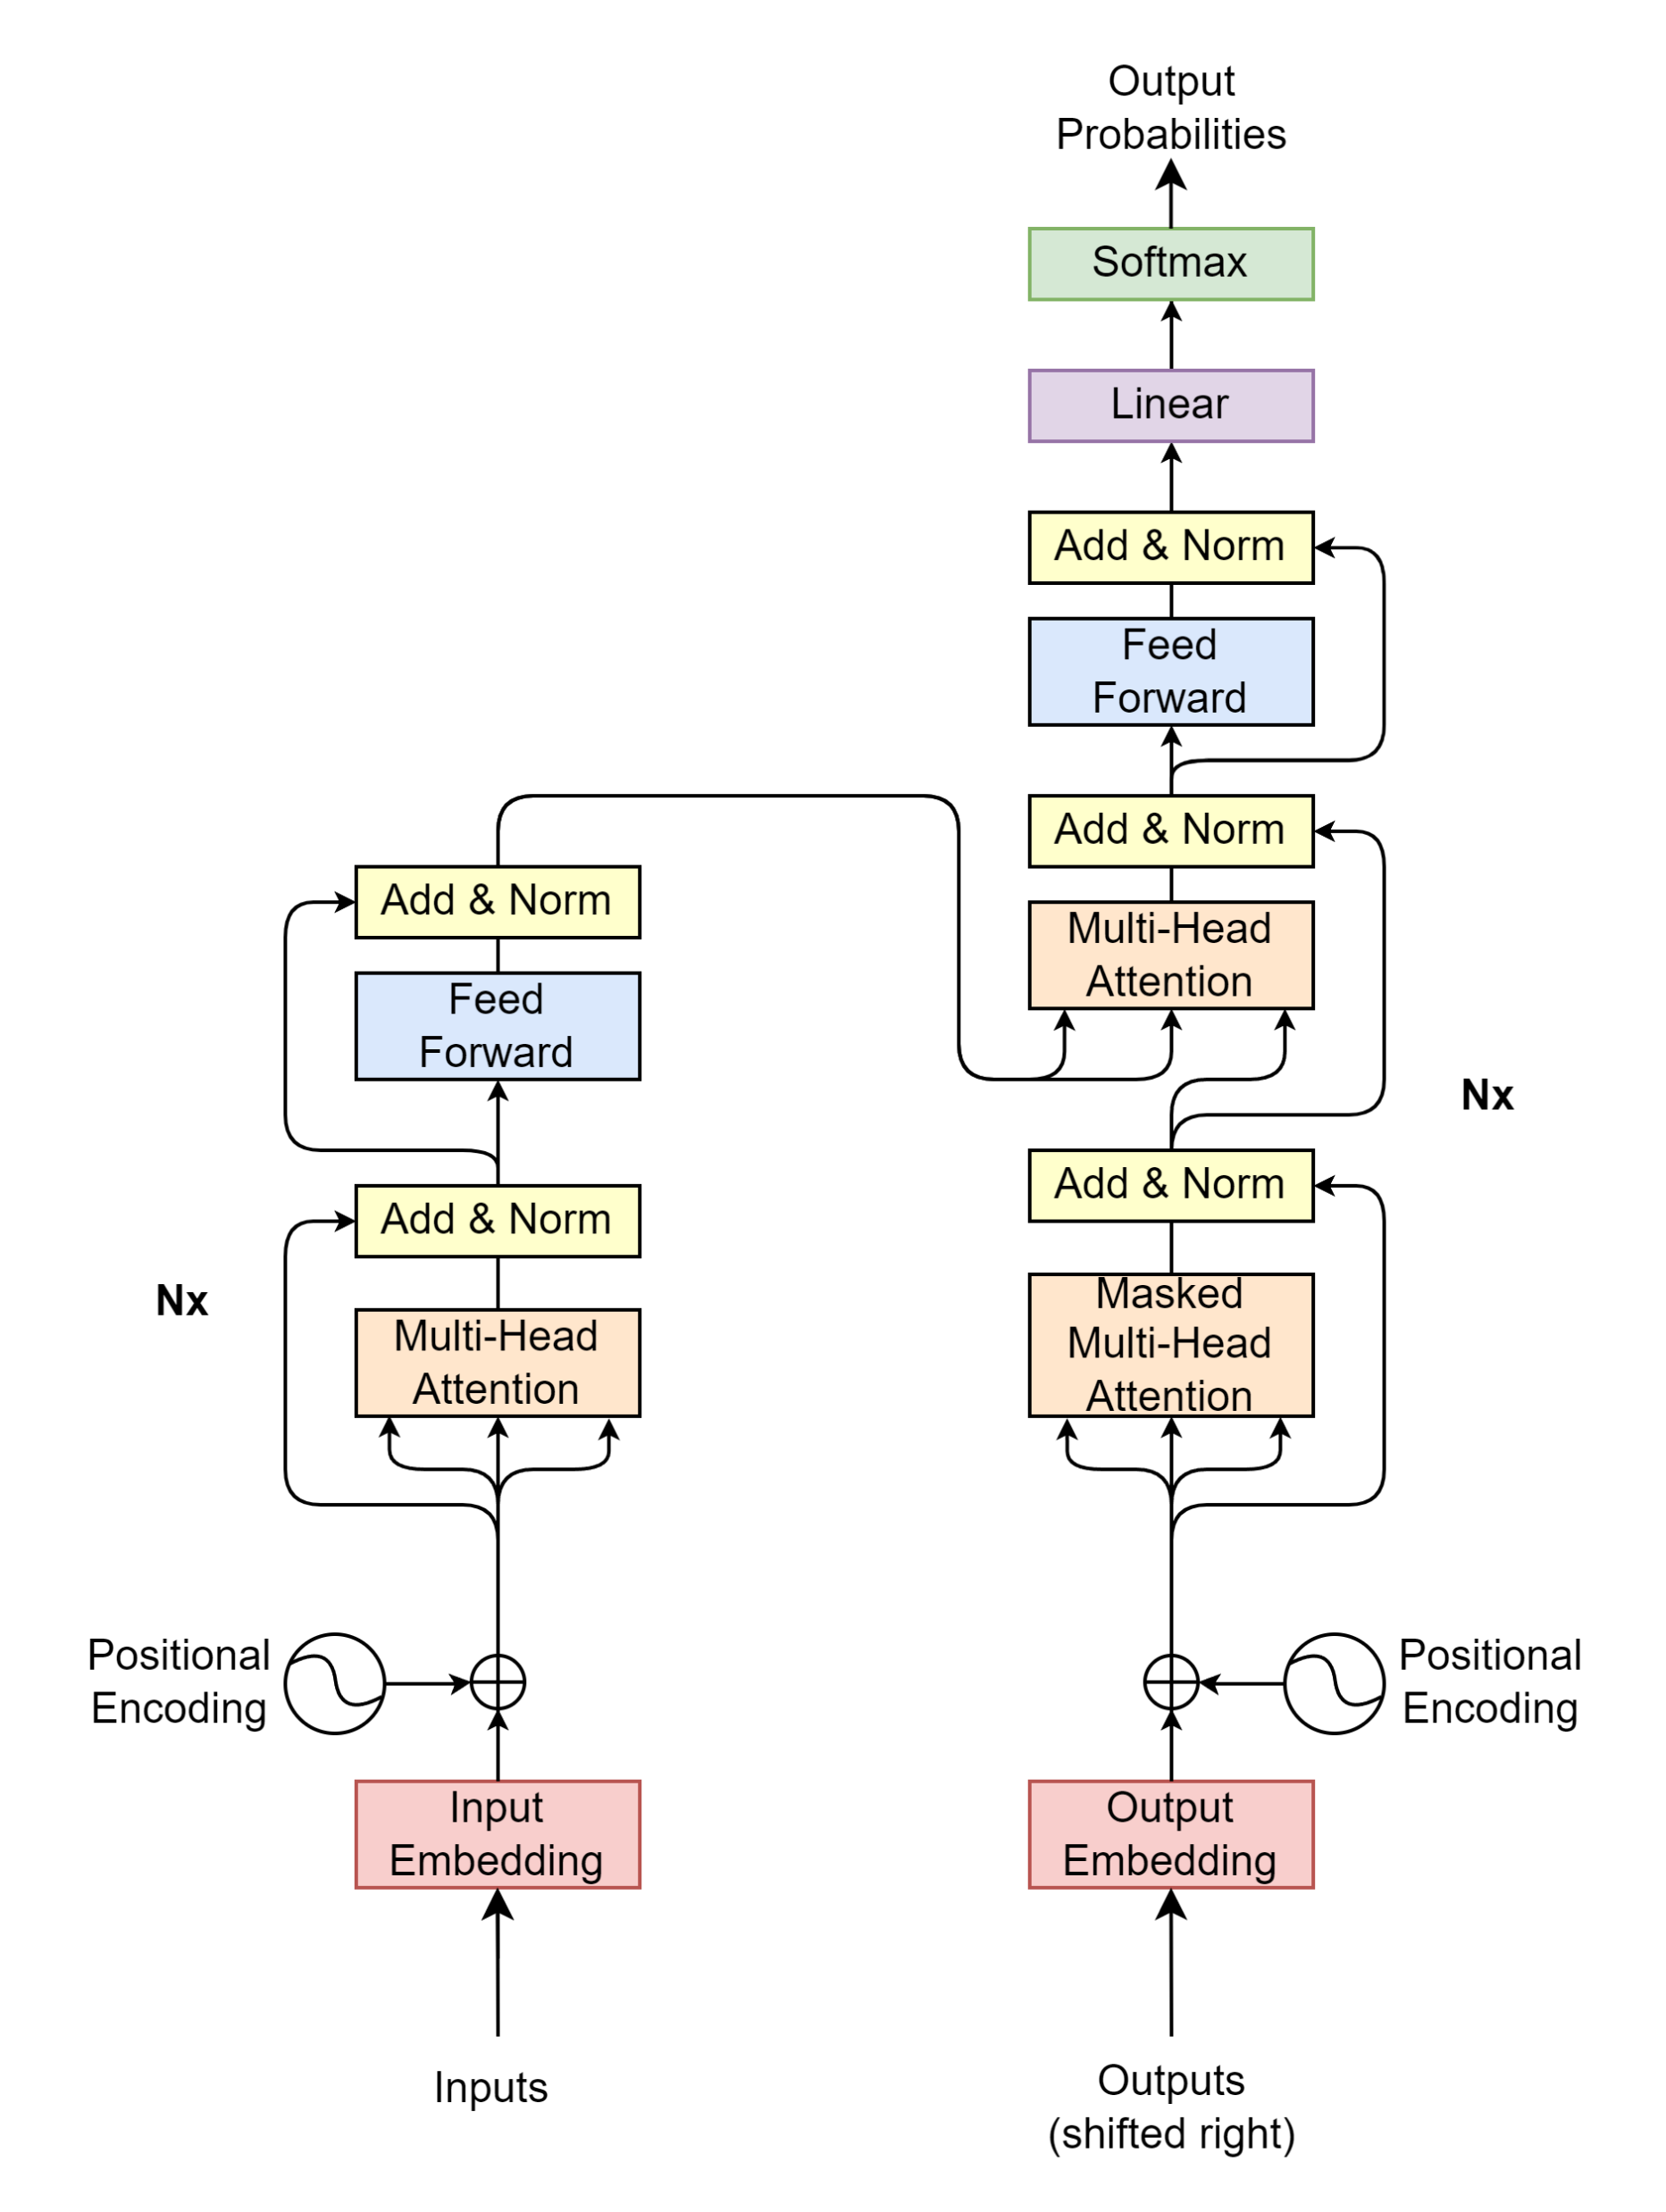

Transformer – Plan of attack
Input/output text data
How does the model understand text data?
Transformer block-by-block
What are the input, output, and process of each block?
What is its meaning?

Slide 15
Inputs/Outputs

Slide 16
Text data → Model
Inputs
Outputs
Source
Target/Label
"I
am
fine"
"Thank
you
very
much"
"Je vais bien"
"Merci beaucoup"

Slide 17
Text data → Model
Inputs
Outputs
Source
Target/Label
The model only understands numerical values
Transform text into numerical representation.
Source and target texts may have different lengths
A fixed sequence length is needed for model computation.
When to start and end the model’s prediction
→ Find ways to notify the model when to start and end the prediction
"I
am
fine"
"Thank
you
very
much"
"Je vais bien"
"Merci beaucoup"

Slide 18
Text data → Model
Inputs
Outputs
Source
Target/Label
The model only understands numerical values
Transform text into numerical representation.
Source and target texts may have different lengths
A fixed sequence length is needed for model computation.
When to start and end the model’s prediction
→ Find ways to notify the model when to start and end the prediction
"I
am
fine"
"Thank
you
very
much"
"Je vais bien"
"Merci beaucoup"
Tokenizer
2
9
107
550
3
1
1
2
2089
95
75
120
3
1
2
69
600
71
3
1
1
2
3546
324
3
1
1
1

Slide 19
Tokenizer
Contains a large vocabulary dictionary
Transforms text to numerical representation
A token can be a word or a character
Special tokens
UNK: Unknown
PAD: Padding
SOS: Start Of Sentence
EOS: End Of Sentence
{
…
"vocab": {
"[UNK]": 0,
"[PAD]": 1,
"[SOS]": 2,
"[EOS]": 3,
"I" : 9,
"you": 24,
"very": 75,
"am" : 107,
"much": 120,
"fine": 550,
"French": 582
"cook": 1779,
"Thank": 2089,
}
…
}

Slide 20
Tokenizer
Tokenizer
"I
am
fine"
encodes
9
107
550
decodes
"I
am
fine"

Slide 21

Put it all together (1/3)
Source (max length: 4)
"I am fine"
"Thank you very much"
"I cook French cuisine"
Fixed length, SOS, EOS
For Inputs
SOS
I
am
fine
EOS
PAD
PAD
SOS
Thank
you
very
much
EOS
PAD
SOS
I
cook
French
cuisine
EOS
PAD
2
9
107
550
3
1
1
2
2089
95
75
120
3
1
2
9
1779
582
0
3
1
$seq$=7
Source tokenizer
encodes

Slide 22
Put it all together (2/3)
Target (max length: 5)
"Je vais bien"
"Merci beaucoup"
"Je fais la cuisine française"
Fixed length, SOS, EOS
For Outputs (shifted right)
SOS
Je
vais
bien
PAD
PAD
PAD
SOS
Merci
beaucoup
PAD
PAD
PAD
PAD
SOS
Je
fais
la
cuisine
française
PAD
2
69
600
71
1
1
1
2
3546
324
1
1
1
1
2
69
1355
9
1390
5309
1
$seq$=7
Target tokenizer
encodes

Slide 23
Put it all together (3/3)
Target
Loss
Target (max length: 5)
"Je vais bien"
"Merci beaucoup"
"Je fais la cuisine française"
Fixed length, SOS, EOS
For Target in loss computation
Je
vais
bien
EOS
PAD
PAD
PAD
Merci
beaucoup
EOS
PAD
PAD
PAD
PAD
Je
fais
la
cuisine
française
EOS
PAD
69
600
71
3
1
1
1
3546
324
3
1
1
1
1
69
1355
9
1390
5309
3
1
$seq$=7
Target tokenizer
encodes

Slide 25
Transformer blocks
Projection
Decoder
Encoder
Encoder Input
Decoder Input

Slide 26
Encoder Input & Decoder Input
Projection
Decoder
Encoder
Encoder Input
Decoder Input

Slide 27

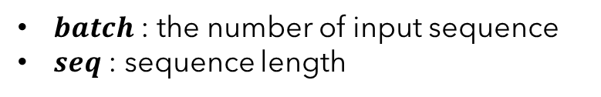


Encoder Input
Positional
Encoding
$batch$ : the number of input sequence
$seq$ : sequence length
Input Embedding
Inputs
$$\left(batch, seq\right)$$
2
9
107
550
3
1
1
"I
am
fine"
tokenizer
encodes
$$seq$$

Slide 28
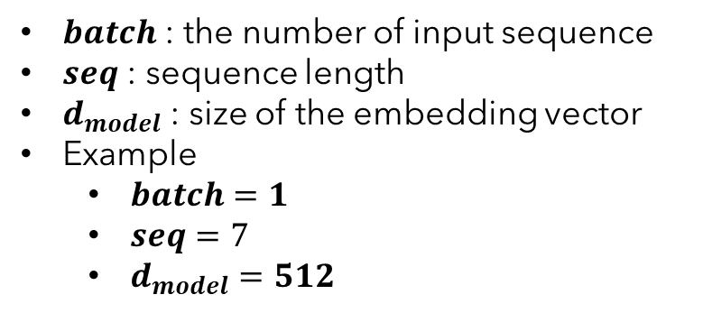


Encoder Input
Positional
Encoding
$batch$ : the number of input sequence
$seq$ : sequence length
$d_{model}$ : size of the embedding vector
Example
$batch=1$
$seq=7$
$d_{model}=512$
$$\left(batch, seq, d_{model}\right)$$
$$\left(batch, seq, d_{model}\right)$$
Input Embedding
Inputs
$$\left(batch, seq\right)$$
2
9
107
550
3
1
1
"I
am
fine"
tokenizer
encodes
$$seq$$

Slide 29


Encoder Input
Encoder Input
Positional
Encoding
$$\left(batch, seq, d_{model}\right)$$
$batch$ : the number of input sequence
$seq$ : sequence length
$d_{model}$ : size of the embedding vector
Example
$batch=1$
$seq=7$
$d_{model}=512$
$$\left(batch, seq, d_{model}\right)$$
$$\left(batch, seq, d_{model}\right)$$
Input Embedding
Inputs
$$\left(batch, seq\right)$$
2
9
107
550
3
1
1
"I
am
fine"
tokenizer
encodes
$$seq$$

Slide 30
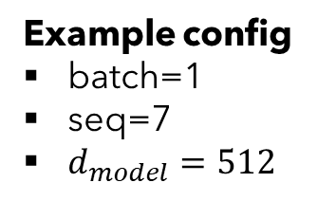
Input Embedding
Example config
batch=1
seq=7
$d_{model}=512$
$$\left(batch, seq, d_{model}\right)$$
Input Embedding
Inputs
$$\left(batch, seq\right)$$
2
9
107
550
3
1
1
"I
am
fine"
tokenizer
encodes
$$seq$$

Slide 31


Input Embedding
$$d_{model}$$
… | … | … | … | …
523.415 | 1265.142 | … | 4189.251 | 16.416
452.716 | 6234.624 | … | 412.414 | 1794.127
7745.984 | 1314.124 | … | 65.764 | 1543.345
… | … | … | … | …
… | … | … | … | …
… | … | … | … | …
$$seq$$
Example config
batch=1
seq=7
$d_{model}=512$
$$\left(batch, seq, d_{model}\right)$$
Input Embedding
Inputs
$$\left(batch, seq\right)$$
2
9
107
550
3
1
1
"I
am
fine"
tokenizer
encodes
$$seq$$

Slide 32
Positional Encoding
Encoder Input
Positional
Encoding
$$\left(batch, seq, d_{model}\right)$$
Example config
batch=1
seq=7
$d_{model}=512$
$$\left(batch, seq, d_{model}\right)$$
$$\left(batch, seq, d_{model}\right)$$
Input Embedding
Inputs
$$\left(batch, seq\right)$$
2
9
107
550
3
1
1
"I
am
fine"
tokenizer
encodes
$$seq$$

Slide 33


Positional Encoding
Example config
batch=1
seq=7
$d_{model}=512$
$$\left(batch, seq, d_{model}\right)$$
Positional
Encoding
Inputs
$$\left(batch, seq\right)$$
2
9
107
550
3
1
1
"I
am
fine"
tokenizer
encodes
$$seq$$

Slide 34





Positional Encoding
$$d_{model}$$
… | … | … | … | …
PE(1,0) | PE(1,1) | … | PE(1,510) | PE(1, 511)
PE(2,0) | PE(2,1) | … | PE(2,510) | PE(2, 511)
PE(3,0) | PE(3,1) | … | PE(3,510) | PE(3, 511)
… | … | … | … | …
… | … | … | … | …
… | … | … | … | …
$$pos=0$$
$pos=$1
$$⋮$$
$$seq$$
Example config
batch=1
seq=7
$d_{model}=512$
$$pos$$
$$=seq−1$$
$$\left(batch, seq, d_{model}\right)$$
Positional
Encoding
Inputs
$$\left(batch, seq\right)$$
2
9
107
550
3
1
1
"I
am
fine"
tokenizer
encodes
$$seq$$

Slide 35


Positional Encoding
$$d_{model}$$
… | … | … | … | …
PE(1,0) | PE(1,1) | … | PE(1,510) | PE(1, 511)
PE(2,0) | PE(2,1) | … | PE(2,510) | PE(2, 511)
PE(3,0) | PE(3,1) | … | PE(3,510) | PE(3, 511)
… | … | … | … | …
… | … | … | … | …
… | … | … | … | …
$$pos=0$$
$pos=$1
$$⋮$$
$$seq$$
Example config
batch=1
seq=7
$d_{model}=512$
$$pos$$
$$=seq−1$$
$$\left(batch, seq, d_{model}\right)$$
PE$\left(pos, 2i\right)=\sin\left(\frac{pos}{{10000}^{\frac{2i}{d_{model}}}}\right)$
Positional
Encoding
PE$\left(pos, 2i+1\right)=\cos\left(\frac{pos}{{10000}^{\frac{2i}{d_{model}}}}\right)$
Inputs
$$\left(batch, seq\right)$$
2
9
107
550
3
1
1
"I
am
fine"
tokenizer
encodes
$$seq$$

Slide 36


Positional Encoding
$$d_{model}$$
… | … | … | … | …
PE(1,0) | PE(1,1) | … | PE(1,510) | PE(1, 511)
PE(2,0) | PE(2,1) | … | PE(2,510) | PE(2, 511)
PE(3,0) | PE(3,1) | … | PE(3,510) | PE(3, 511)
… | … | … | … | …
… | … | … | … | …
… | … | … | … | …
$$pos=0$$
$pos=$1
$$⋮$$
$$seq$$
Example config
batch=1
seq=7
$d_{model}=512$
$$pos$$
$$=seq−1$$
$$\left(batch, seq, d_{model}\right)$$
PE$\left(pos, 2i\right)=\sin\left(\frac{pos}{{10000}^{\frac{2i}{d_{model}}}}\right)$
Positional
Encoding
PE$\left(pos, 2i+1\right)=\cos\left(\frac{pos}{{10000}^{\frac{2i}{d_{model}}}}\right)$
Inputs
$$\left(batch, seq\right)$$
2
9
107
550
3
1
1
"I
am
fine"
tokenizer
encodes
$$seq$$

Slide 37
Positional Encoding
$$d_{model}$$
… | … | … | … | …
PE(1,0) | PE(1,1) | … | PE(1,510) | PE(1, 511)
PE(2,0) | PE(2,1) | … | PE(2,510) | PE(2, 511)
PE(3,0) | PE(3,1) | … | PE(3,510) | PE(3, 511)
… | … | … | … | …
… | … | … | … | …
… | … | … | … | …
$$pos=0$$
$pos=$1
$$⋮$$
$$seq$$
Example config
batch=1
seq=7
$d_{model}=512$
$$pos$$
$$=seq−1$$
$$\left(batch, seq, d_{model}\right)$$
PE$\left(pos, 2i\right)=\sin\left(\frac{pos}{{10000}^{\frac{2i}{d_{model}}}}\right)$
Positional
Encoding
PE$\left(pos, 2i+1\right)=\cos\left(\frac{pos}{{10000}^{\frac{2i}{d_{model}}}}\right)$
Inputs
$$\left(batch, seq\right)$$
2
9
107
550
3
1
1
"I
am
fine"
tokenizer
encodes
$$seq$$

Slide 38
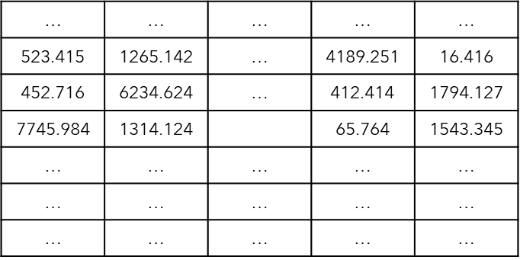
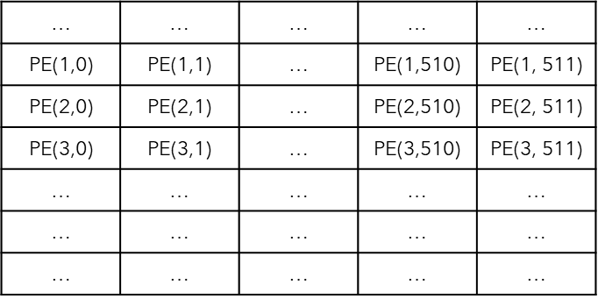




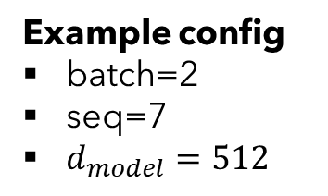





Put it all together
Encoder Input
Example config
batch=2
seq=7
$d_{model}=512$
Positional
Encoding
$$\left(batch, seq, d_{model}\right)$$
$$d_{model}$$
$$\left(batch, seq, d_{model}\right)$$
$$\left(batch, seq, d_{model}\right)$$
$$seq$$
Input Embedding
$$batch$$
Inputs
$$\left(batch, seq\right)$$
2
9
107
550
3
1
1
2
2089
95
75
120
3
1
$$batch$$
"I
am
fine"
"Thank
you
very
much"
$$seq$$

Slide 39
Encoder
Projection
Decoder
Encoder
Encoder Input
Decoder Input

Slide 40
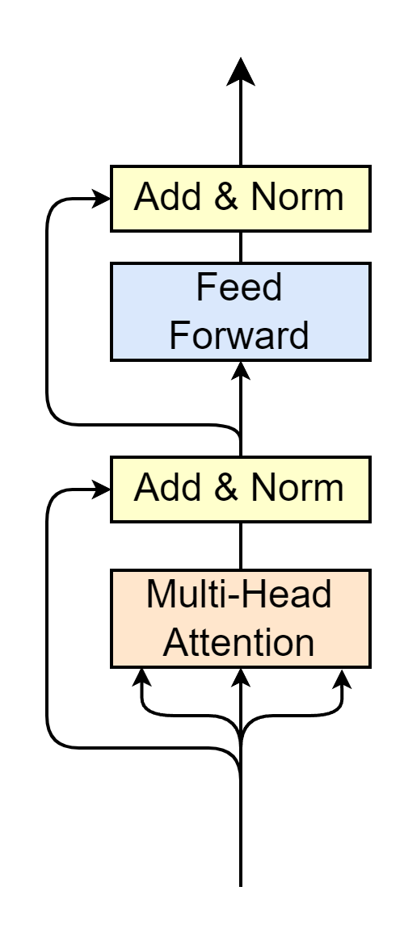
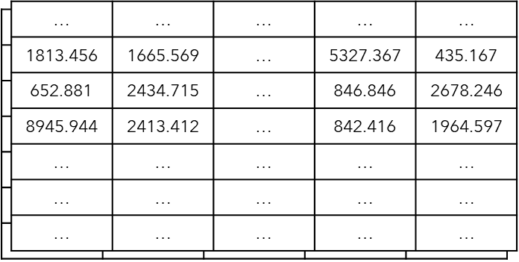



Encoder
Encoder Output
$$\left(batch, seq, d_{model}\right)$$
Multi-Head Attention
Self-Attention
Layer Normalization
Feed Forward
Residual connection
Residual Connection
$$N_{x}$$
Encoder Input
"Word meaning + position feature"
$$\left(batch, seq, d_{model}\right)$$

Slide 41
Encoder
Encoder Output
$$\left(batch, seq, d_{model}\right)$$
Multi-Head Attention
Self-Attention
Layer Normalization
Feed Forward
Residual connection
Residual Connection
$$N_{x}$$
Encoder Input
$$\left(batch, seq, d_{model}\right)$$

Slide 42
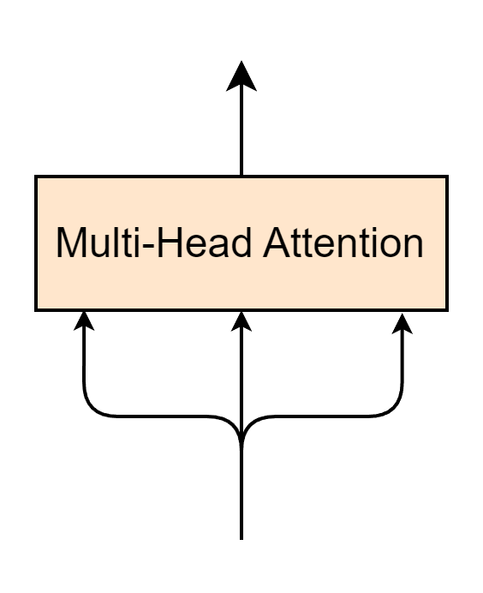








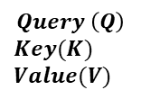
Multi-Head Attention Layer
$$\left(batch, seq, d_{model}\right)$$
$$Q$$
$$K$$
$$V$$
Encoder Input
$$Query \left(Q\right)$$
$$Key(K)$$
$$Value(V)$$
$$\left(batch, seq, d_{model}\right)$$
$$seq$$
$$≡$$
$$batch$$
$$d_{model}$$
"Word meaning + position feature"

Slide 43
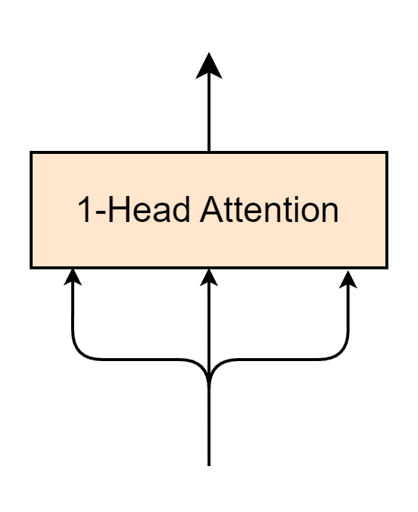
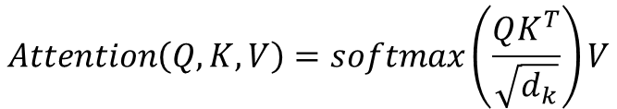
1-Head Attention Layer
$$\left(batch, seq, d_{model}\right)$$
$$Attention\left(Q, K, V\right)=softmax\left(\frac{QK^{T}}{\sqrt{d_{k}}}\right)V$$
$$Q$$
$$K$$
$$V$$
Encoder Input
$$\left(batch, seq, d_{model}\right)$$

Slide 44
1-Head Attention Layer – Self Attention
Self-Attention
$$\left(batch, seq, d_{model}\right)$$
$$Attention\left(Q, K, V\right)=softmax\left(\frac{QK^{T}}{\sqrt{d_{k}}}\right)V$$
$$Q$$
$$K$$
$$V$$
Encoder Input
$$\left(batch, seq, d_{model}\right)$$

Slide 45

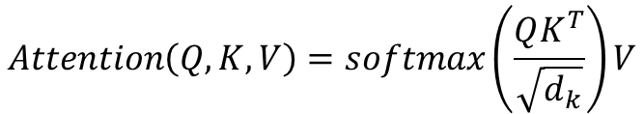






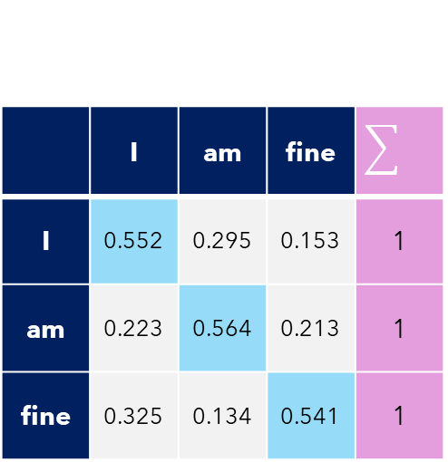

Self-Attention
Self-Attention
Example config
batch=1
seq=3
$d_{model}=d_{k}=512$
$$Attention\left(Q, K, V\right)=softmax\left(\frac{QK^{T}}{\sqrt{d_{k}}}\right)V$$
$$K^{T}(512,3)$$
$$Q(3, 512)$$
1813.456 | 652.881 | 8945.944
1665.569 | 2434.715 | 2413.412
… | … | …
5327.367 | 846.846 | 842.416
435.167 | 2678.246 | 1964.597
Self-Attention$(3,3)$
1813.456 | 1665.569 | … | 5327.367 | 435.167
652.881 | 2434.715 | … | 846.846 | 2678.246
8945.944 | 2413.412 | … | 842.416 | 1964.597
$$×$$
 | I | am | fine
I | 0.552 | 0.295 | 0.153 | 1
am | 0.223 | 0.564 | 0.213 | 1
fine | 0.325 | 0.134 | 0.541 | 1
$$softmax$$
$$=$$
$$\sqrt{512}$$
Self-attention -> Words to relate to each other

Slide 46






1-Head Attention Layer
1-Head Attention
Self-Attention
Example config
batch=1
seq=3
$d_{model}=d_{k}=512$
$$Attention\left(Q, K, V\right)=softmax\left(\frac{QK^{T}}{\sqrt{d_{k}}}\right)V$$
Self-Attention$(3,3)$
 | I | am | fine
I | 0.552 | 0.295 | 0.153 | 1
am | 0.223 | 0.564 | 0.213 | 1
fine | 0.325 | 0.134 | 0.541 | 1
V$(3, 512)$
Attention$(3, 512)$
1813.456 | 1665.569 | … | 5327.367 | 435.167
652.881 | 2434.715 | … | 846.846 | 2678.246
8945.944 | 2413.412 | … | 842.416 | 1964.597
… | … | … | … | …
… | … | … | … | …
… | … | … | … | …
$$×$$
$$=$$
"Word meaning + position feature"
"Word meaning + position feature"
"Relate words to each other"
"Relate words to each other"

Slide 47
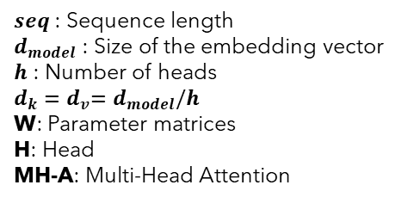
Multi-Head Attention
$seq$ : Sequence length
$d_{model}$ : Size of the embedding vector
$h$ : Number of heads
$d_{k}{=d}_{v}=d_{model}/h$
W: Parameter matrices
H: Head
MH-A: Multi-Head Attention

Slide 48
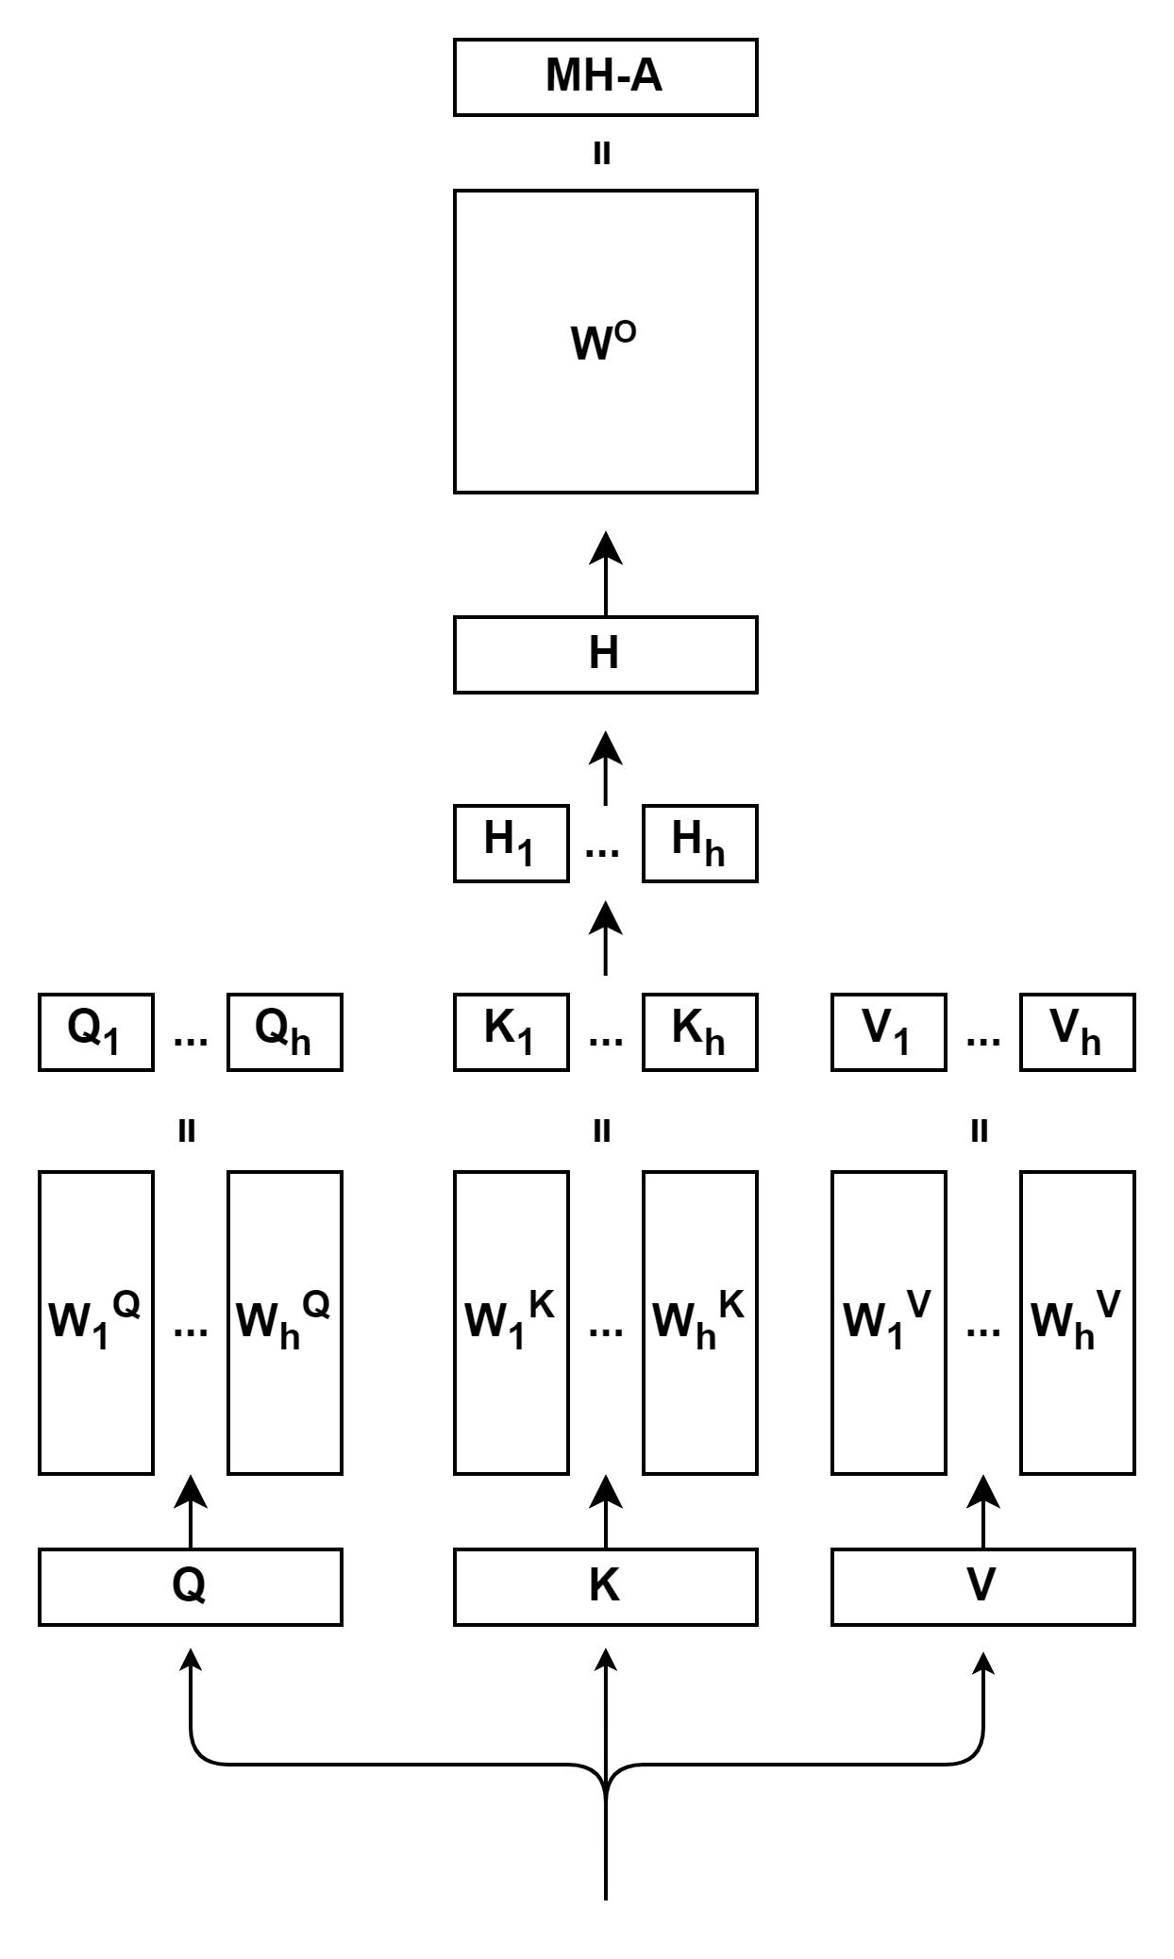
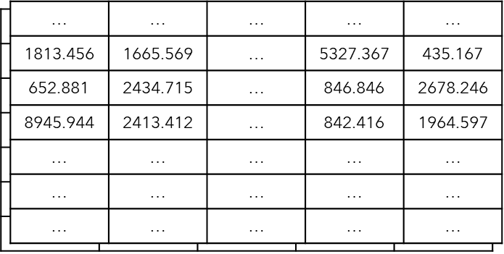
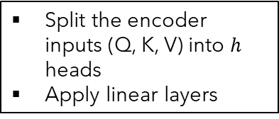




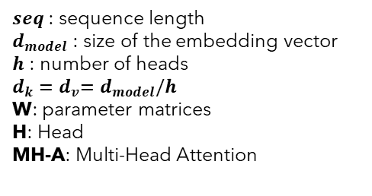


Multi-Head Attention
$seq$ : sequence length
$d_{model}$ : size of the embedding vector
$h$ : number of heads
$d_{k}{=d}_{v}=d_{model}/h$
W: parameter matrices
H: Head
MH-A: Multi-Head Attention
$$\left(batch, seq, d_{k}\right)$$
$$×$$
$$\left(batch,d_{model}, d_{k}\right)$$
Split the encoder inputs (Q, K, V) into $h$ heads
Apply linear layers
$$batch$$
$$d_{model}$$
$$\left(batch, seq, d_{model}\right)$$
$$seq$$
Encoder Input
$$\left(batch, seq, d_{model}\right)$$

Slide 49



Multi-Head Attention
$seq$ : sequence length
$d_{model}$ : size of the embedding vector
$h$ : number of heads
$d_{k}{=d}_{v}=d_{model}/h$
W: parameter matrices
H: Head
MH-A: Multi-Head Attention
$$\left(batch, seq, d_{v}\right)$$
$${Head}_{i}=Attention\left(QW_{i}^{Q},KW_{i}^{K},VW_{i}^{V}\right)$$
$$Attention\left(Q, K, V\right)=softmax\left(\frac{QK^{T}}{\sqrt{d_{k}}}\right)V$$
$$\left(batch, seq, d_{k}\right)$$
$$×$$
$$\left(batch,d_{model}, d_{k}\right)$$
Split the encoder inputs (Q, K, V) into $h$ heads
Apply linear layers
$$batch$$
$$d_{model}$$
$$\left(batch, seq, d_{model}\right)$$
$$seq$$
Encoder Input
$$\left(batch, seq, d_{model}\right)$$

Slide 50


Multi-Head Attention
$seq$ : sequence length
$d_{model}$ : size of the embedding vector
$h$ : number of heads
$d_{k}{=d}_{v}=d_{model}/h$
W: parameter matrices
H: Head
MH-A: Multi-Head Attention
$$\left(batch, seq, d_{model}\right)$$
$$Concat\left(head_{1},⋯,head_{h}\right)$$
$$\left(batch, seq, d_{v}\right)$$
$${Head}_{i}=Attention\left(QW_{i}^{Q},KW_{i}^{K},VW_{i}^{V}\right)$$
$$Attention\left(Q, K, V\right)=softmax\left(\frac{QK^{T}}{\sqrt{d_{k}}}\right)V$$
$$\left(batch, seq, d_{k}\right)$$
$$×$$
$$\left(batch,d_{model}, d_{k}\right)$$
Split the encoder inputs (Q, K, V) into $h$ heads
Apply linear layers
$$batch$$
$$d_{model}$$
$$\left(batch, seq, d_{model}\right)$$
$$seq$$
Encoder Input
$$\left(batch, seq, d_{model}\right)$$

Slide 51



Multi-Head Attention
$$\left(batch, seq, d_{model}\right)$$
$seq$ : sequence length
$d_{model}$ : size of the embedding vector
$h$ : number of heads
$d_{k}{=d}_{v}=d_{model}/h$
W: parameter matrices
H: Head
MH-A: Multi-Head Attention
$$×$$
$$\left(batch,d_{model}, d_{model}\right)$$
Apply a linear layer
$$\left(batch, seq, d_{model}\right)$$
$$Concat\left(head_{1},⋯,head_{h}\right)$$
$$\left(batch, seq, d_{v}\right)$$
$${Head}_{i}=Attention\left(QW_{i}^{Q},KW_{i}^{K},VW_{i}^{V}\right)$$
$$Attention\left(Q, K, V\right)=softmax\left(\frac{QK^{T}}{\sqrt{d_{k}}}\right)V$$
$$\left(batch, seq, d_{k}\right)$$
$$×$$
$$\left(batch,d_{model}, d_{k}\right)$$
Split the encoder inputs (Q, K, V) into $h$ heads
Apply linear layers
$$batch$$
$$d_{model}$$
$$\left(batch, seq, d_{model}\right)$$
$$seq$$
Encoder Input
$$\left(batch, seq, d_{model}\right)$$

Slide 52

Encoder
Encoder Output
$$\left(batch, seq, d_{model}\right)$$
Multi-Head Attention
Self-Attention
Layer Normalization
Feed Forward
Residual connection
Residual Connection
$$N_{x}$$
Encoder Input
$$\left(batch, seq, d_{model}\right)$$

Slide 53
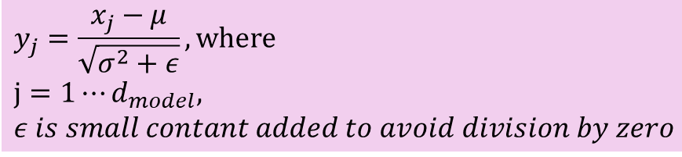

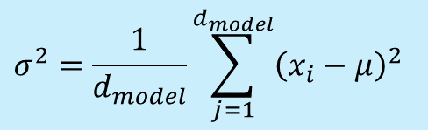
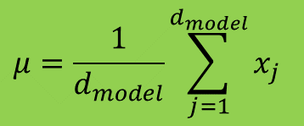




Layer Normalization
Given a feature vector of a token, having length of $d_{model}$
Calculate mean
Calculate variance
Normalization
$$x_{1}$$
$$x_{d_{model}}$$
 |  | …
$$μ=\frac{1}{d_{model}}\sum_{j=1}^{d_{model}}{x_{j}}$$
$$σ^{2}=\frac{1}{d_{model}}\sum_{j=1}^{d_{model}}{{\left(x_{i}−μ\right)}^{2}}$$
$$y_{j}=\frac{x_{j}−μ}{\sqrt{σ^{2}+ε}}, where$$
$$j=1⋯d_{model},$$
$ε is small contant added to avoid division by zero$
$$y_{1}$$
$$y_{d_{model}}$$
 |  | …

Slide 54
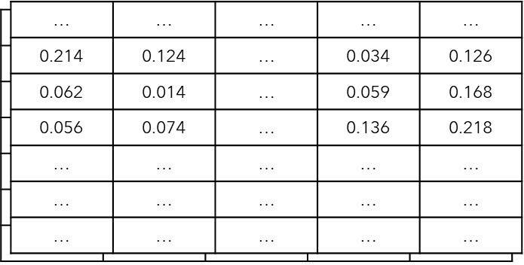
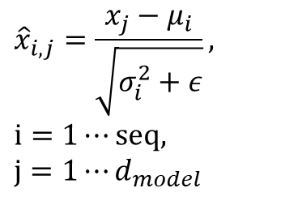


Put it all together
$$\left(batch, seq,d_{model}\right)$$
$${\hat{x}}_{i,j}=\frac{x_{j}−μ_{i}}{\sqrt{σ_{i}^{2}+ε}},$$
$$i=1⋯seq,$$
$$j=1⋯d_{model}$$
Layer Normalization
$$\left(batch, seq,d_{model}\right)$$
$$batch$$
$$seq$$
$$d_{model}$$

Slide 55
Encoder
Encoder Output
$$\left(batch, seq, d_{model}\right)$$
Multi-Head Attention
Self-Attention
Layer Normalization
Feed Forward
Residual connection
Residual Connection
$$N_{x}$$
Encoder Input
$$\left(batch, seq, d_{model}\right)$$

Slide 56
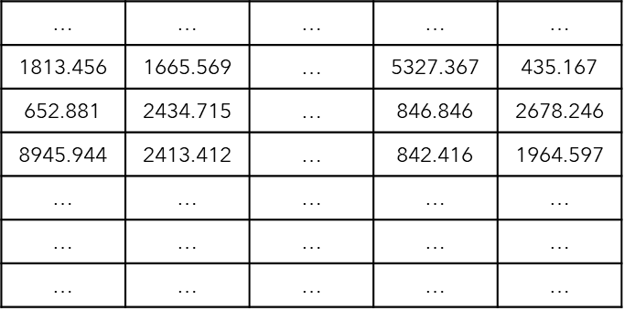


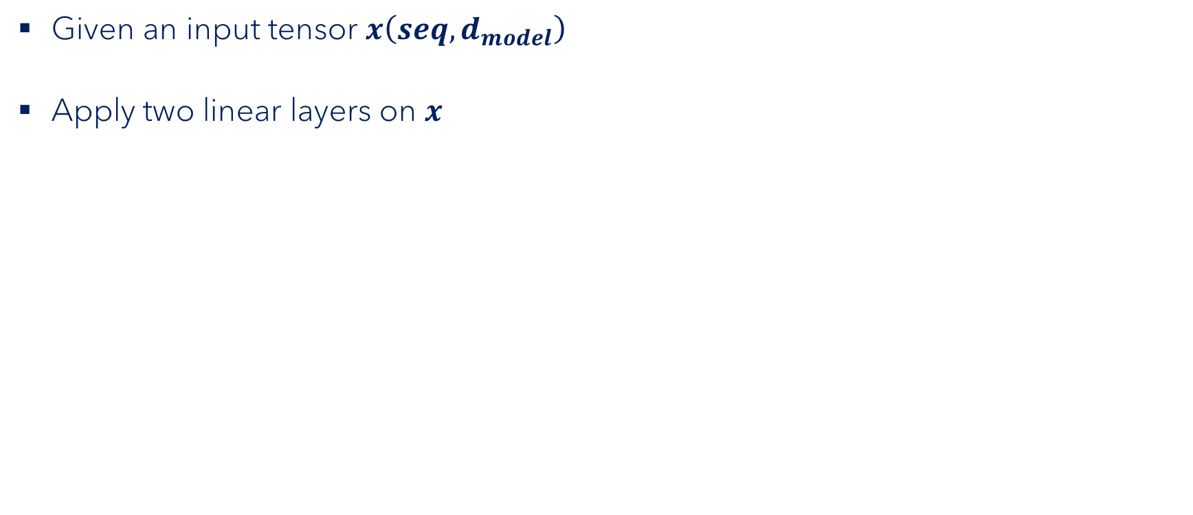








Feed Forward
$$seq$$
Given an input tensor $x\left(seq,d_{model}\right)$
Apply two linear layers on $x$
Obtain output tensor$y\left(seq,d_{model}\right)$
$$d_{model}$$
$$W_{1}$$
$$x$$
$$×$$
$$+$$
$$b_{1}$$
$$\left(seq,d_{model}\right)$$
$$\left(d_{model},d_{ff}\right)$$
$$Linear layer 1 \left(seq,d_{ff}\right)$$

Slide 57

Feed Forward
$$seq$$
Given an input tensor $x\left(seq,d_{model}\right)$
Apply two linear layers on $x$
Obtain output tensor$y\left(seq,d_{model}\right)$
$$d_{model}$$
$$W_{1}$$
$$x$$
$$×$$
$$+$$
$$b_{1}$$
$$ReLU$$
$$\left(seq,d_{model}\right)$$
$$\left(d_{model},d_{ff}\right)$$
$$Linear layer 1 \left(seq,d_{ff}\right)$$

Slide 58

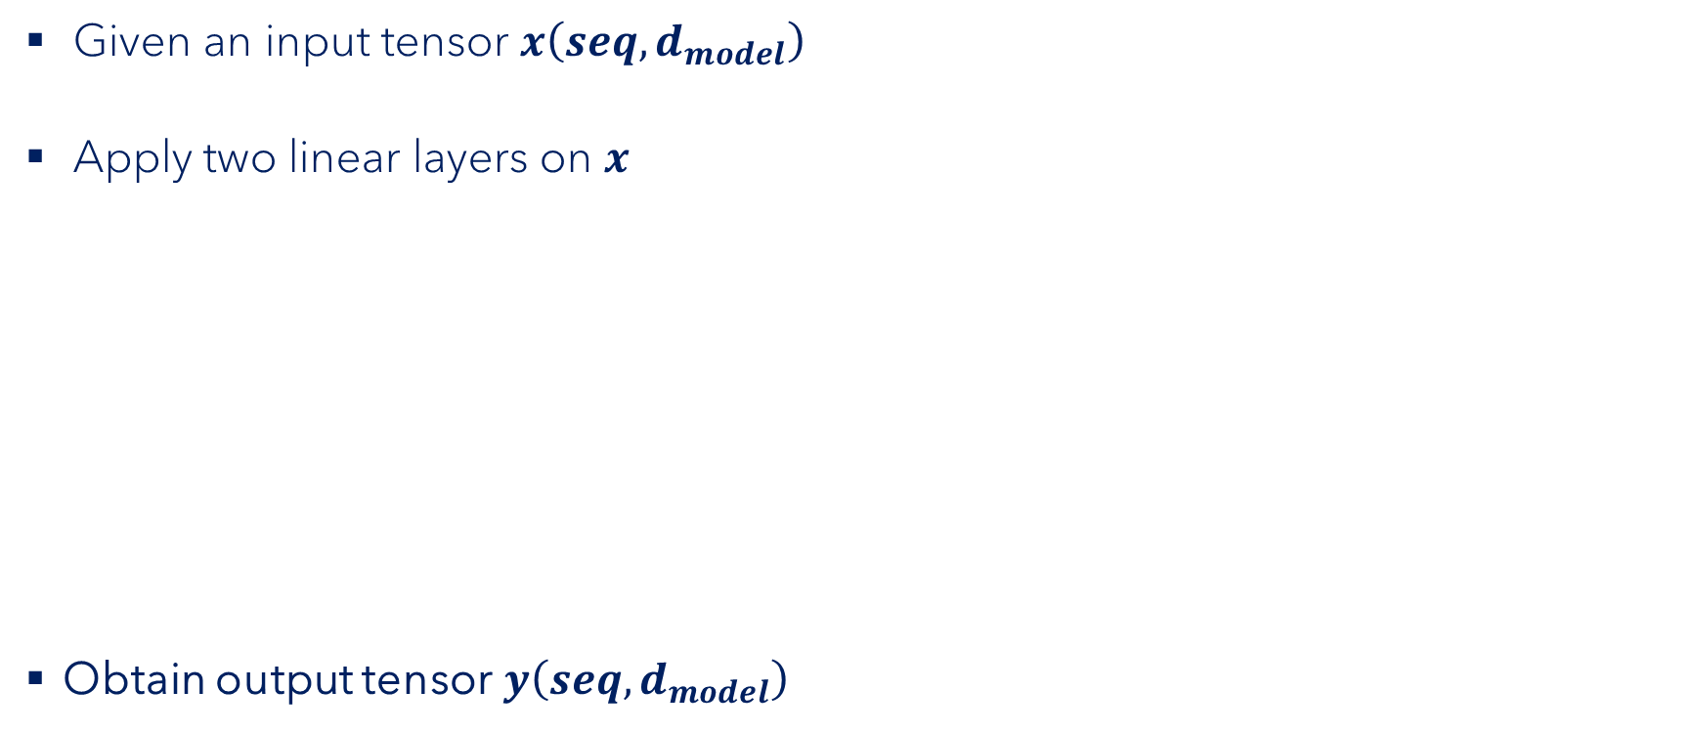






Feed Forward
$$seq$$
Given an input tensor $x\left(seq,d_{model}\right)$
Apply two linear layers on $x$
Obtain output tensor$y\left(seq,d_{model}\right)$
$$d_{model}$$
$$y=FF\left(x\right)=ReLU\left(x{×W}_{1}+b_{1}\right)×W_{2}+b_{2} , where ReLU\left(x\right)=max(0,x)$$
$$W_{1}$$
$$W_{2}$$
$$FF\left(x\right)=$$
$$x$$
$$×$$
$$+$$
$$b_{1}$$
$$×$$
$$+$$
$$b_{2}$$
$$ReLU$$
$$\left(seq,d_{model}\right)$$
$$\left(d_{ff},d_{model}\right)$$
$$\left(d_{model},d_{ff}\right)$$
$$Linear layer 1 \left(seq,d_{ff}\right)$$
$$Linear layer 2 \left(seq,d_{model}\right)$$

Slide 59
Encoder
Encoder Output
$$\left(batch, seq, d_{model}\right)$$
Multi-Head Attention
Self-Attention
Layer Normalization
Feed Forward
Residual connection
Residual Connection
$$N_{x}$$
Encoder Input
$$\left(batch, seq, d_{model}\right)$$

Slide 60


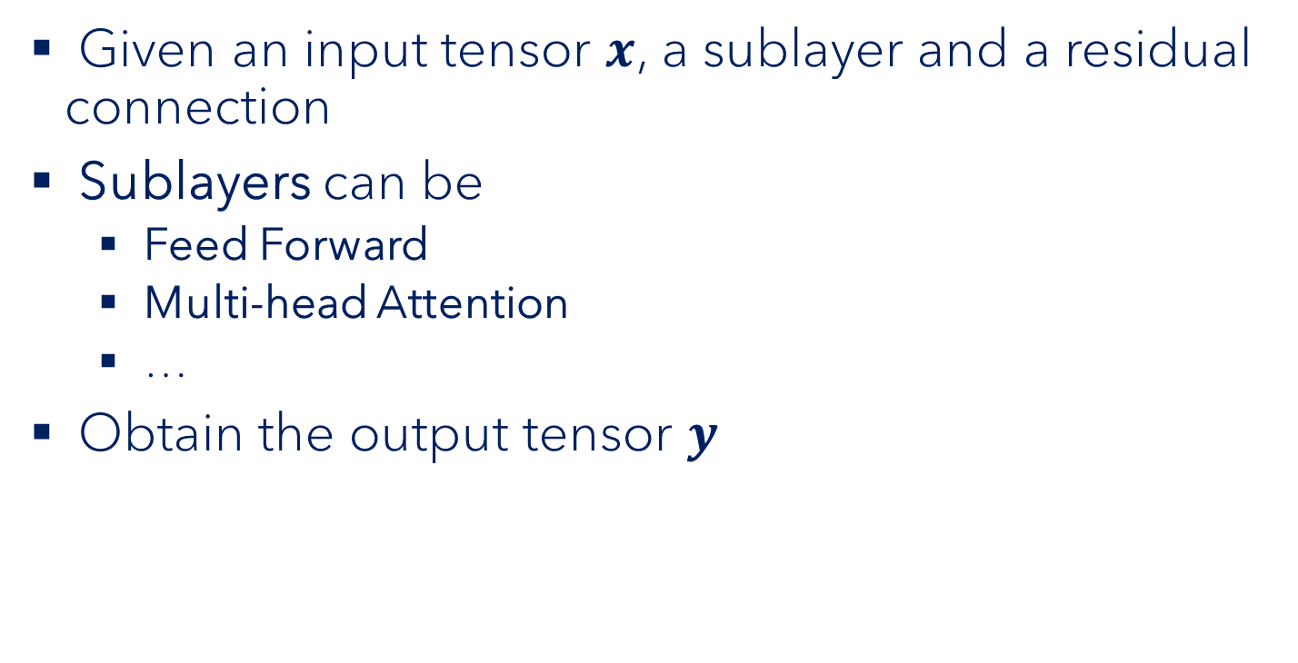



Residual Connection
$$y$$
$$+$$
Given an input tensor $x$, a sublayer and a residual connection
Sublayers can be
Feed Forward
Multi-head Attention
…
Obtain the output tensor $y$
$$Sublayer$$
$$x$$
$$y =x+sublayer(x)$$

Slide 61

Encoder
Encoder Output
$$\left(batch, seq, d_{model}\right)$$
Multi-Head Attention
Self-Attention
Layer Normalization
Feed Forward
Residual connection
Residual Connection
$N_{x}$=6
Encoder Input
$$\left(batch, seq, d_{model}\right)$$

Slide 62
Decoder
Projection
Decoder
Encoder
Encoder Input
Decoder Input

Slide 63
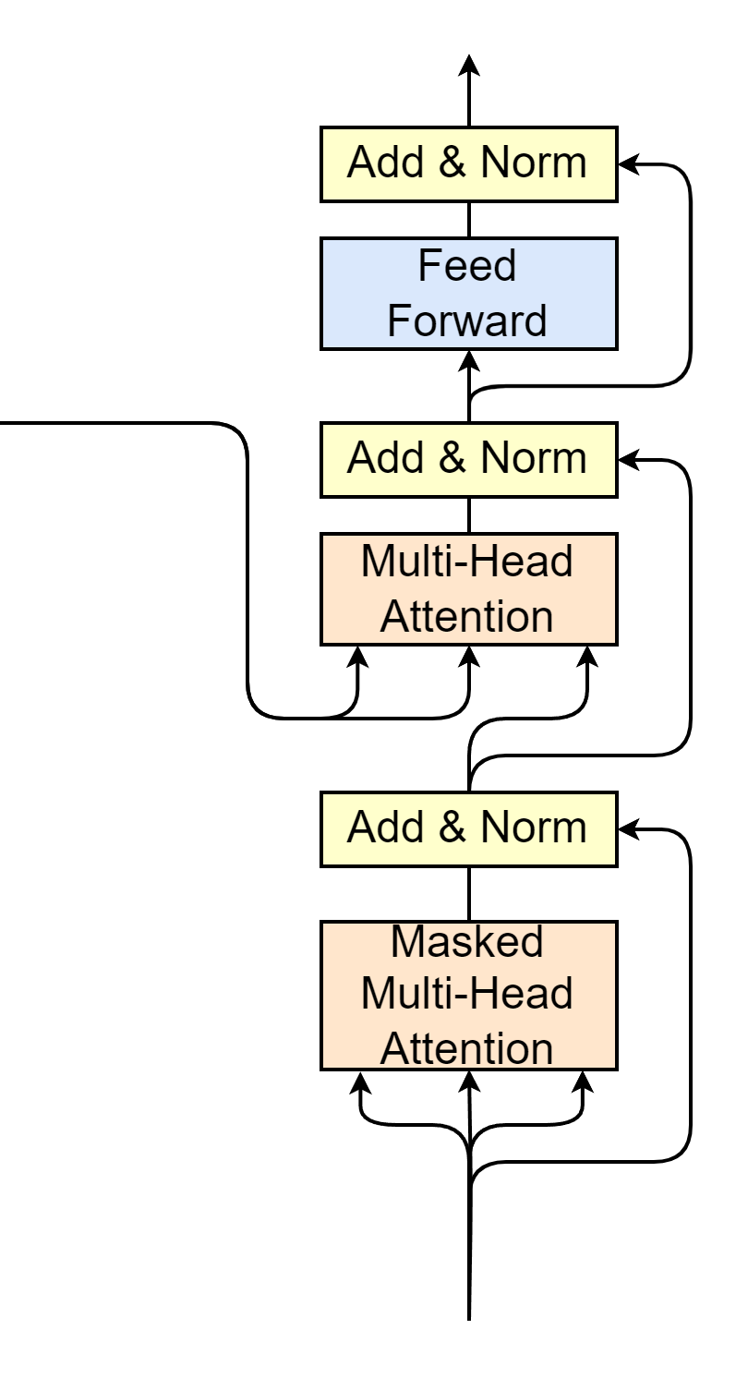

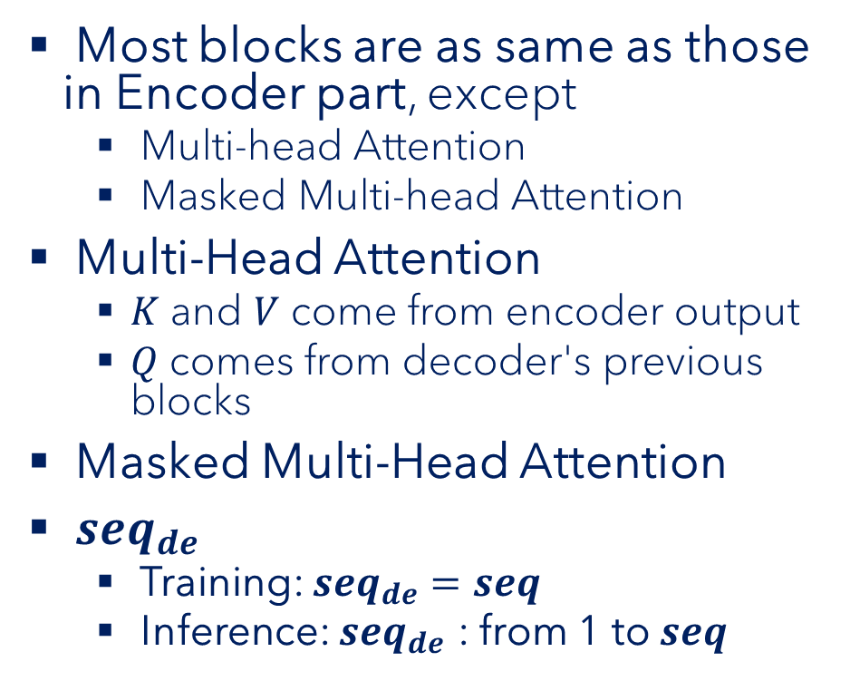







Decoder
Decoder Input
$$\left(batch, seq_{de}, d_{model}\right)$$
Most blocks are as same as those in Encoder part, except
Multi-head Attention
Masked Multi-head Attention
Multi-Head Attention
$K$ and $V$ come from encoder output
$Q$ comes from decoder's previous blocks
Masked Multi-Head Attention
$seq_{de}$
Training: $seq_{de}=seq$
Inference: $seq_{de}$ : from 1 to $seq$
Encoder Output
$$\left(batch, seq, d_{model}\right)$$
$$K$$
$$V$$
$$Q$$
$$N_{x}$$
$$\left(batch, seq_{de}, d_{model}\right)$$
Decoder Input
$$\left(batch, seq_{de}, d_{model}\right)$$

Slide 64


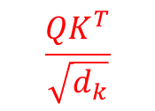
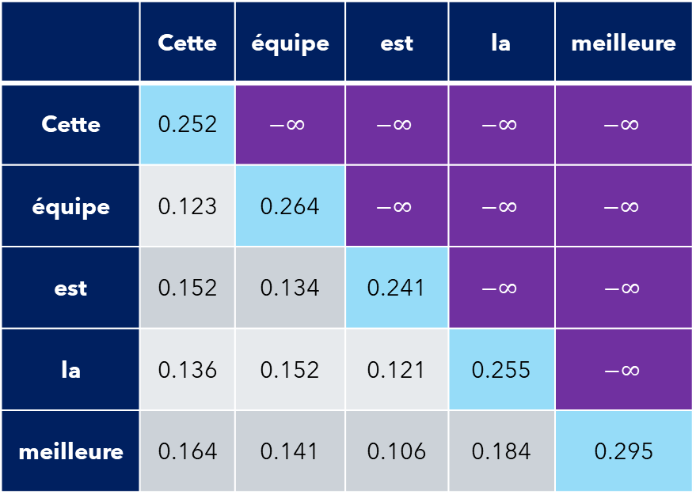
Masked Multi-Head Attention
$$Attention\left(Q, K, V\right)=softmax\left(\frac{QK^{T}}{\sqrt{d_{k}}}\right)V$$
Self-attention
$$\frac{QK^{T}}{\sqrt{d_{k}}}$$
Apply mask matrix
Each word only correlates with previous words
 | Cette | équipe | est | la | meilleure
Cette | 0.252 | $$−∞$$ | $$−∞$$ | $$−∞$$ | $$−∞$$
équipe | 0.123 | 0.264 | $$−∞$$ | $$−∞$$ | $$−∞$$
est | 0.152 | 0.134 | 0.241 | $$−∞$$ | $$−∞$$
la | 0.136 | 0.152 | 0.121 | 0.255 | $$−∞$$
meilleure | 0.164 | 0.141 | 0.106 | 0.184 | 0.295
 | Cette | équipe | est | la | meilleure
Cette | 1.0 | 0 | 0 | 0 | 0
équipe | 0.465 | 0.525 | 0 | 0 | 0
est | 0.325 | 0.319 | 0.356 | 0 | 0
la | 0.242 | 0.246 | 0.239 | 0.273 | 0
meilleure | 0.197 | 0.192 | 0.186 | 0.201 | 0.224
$$softmax$$

Slide 65
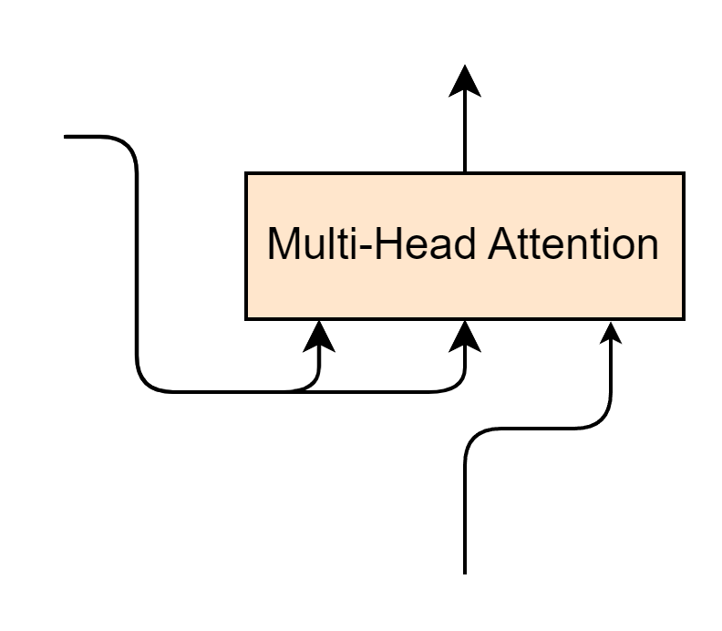




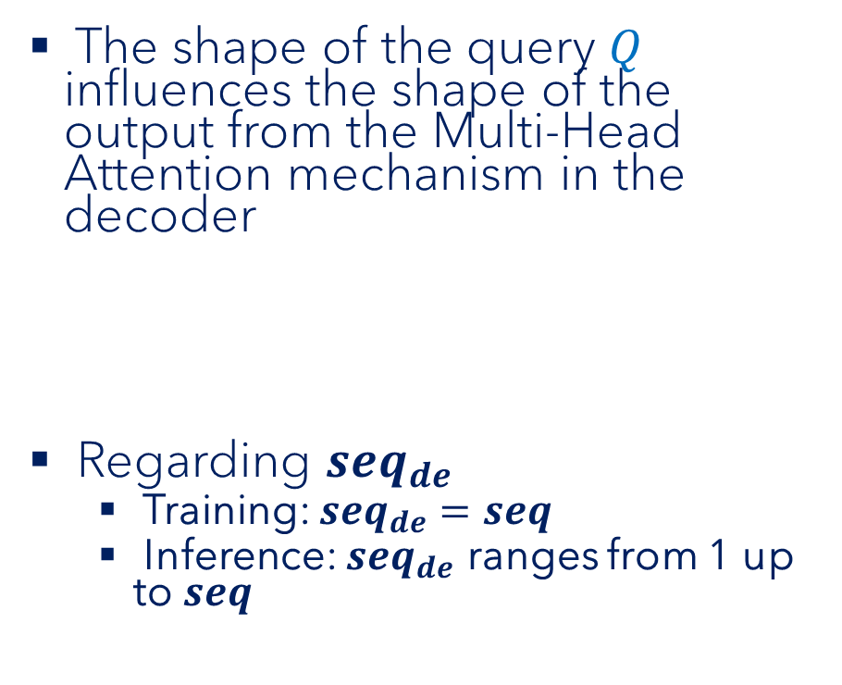



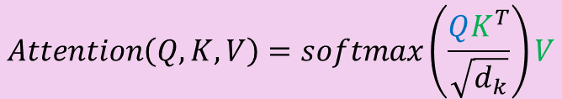



Multi-Head Attention of Decoder
The shape of the query $Q$ influences the shape of the output from the Multi-Head Attention mechanism in the decoder
Regarding $seq_{de}$
Training: $seq_{de}=seq$
Inference: $seq_{de}$ ranges from 1 up to $seq$
$$\left(batch, seq_{de}, d_{model}\right)$$
Encoder Output
$$\left(batch, seq, d_{model}\right)$$
$$K$$
$$V$$
$$Q$$
$$Q$$
$$K^{T}$$
$$V$$
$$\left(\left(seq_{de}, d_{model}\right)×\left(d_{model},seq\right)\right)×(seq, d_{model})$$
$$\left(seq_{de}, d_{model}\right)$$
$$\left(batch, seq_{de}, d_{model}\right)$$
$$Attention\left(Q, K, V\right)=softmax\left(\frac{QK^{T}}{\sqrt{d_{k}}}\right)V$$

Slide 66



Decoder
Decoder Output
$$\left(batch, seq, d_{model}\right)$$
Multi-Head Attention
Masked Multi-Head Attention
Encoder Output
$$\left(batch, seq, d_{model}\right)$$
$$K$$
$$V$$
$$Q$$
$N_{x}$=6
Decoder Input
$$\left(batch, seq_{decoder}, d_{model}\right)$$

Slide 67
Transformer prediction
Projection layer
Linear layer
Softmax
Projection
Decoder
Encoder
Encoder Input
Decoder Input

Slide 68
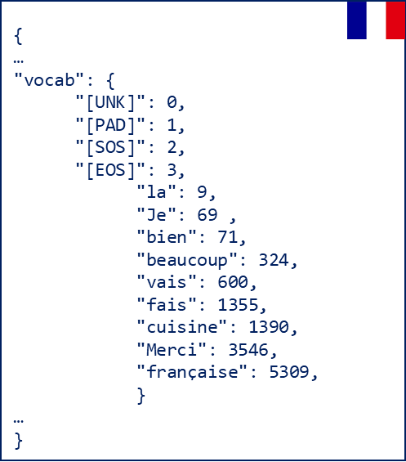



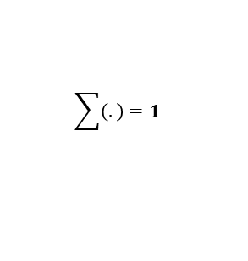







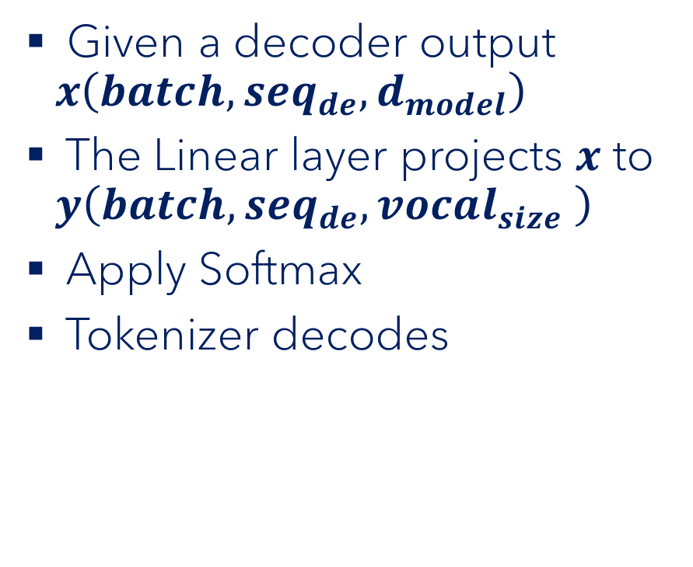



Transformer prediction
Target Tokenizer
"Je"
Given a decoder output $x\left(batch, seq_{de},d_{model}\right)$
The Linear layer projects $x$ to $y\left(batch, seq_{de},vocal_{size} \right)$
Apply Softmax
Tokenizer decodes
decode
$$vocal_size=10000$$
$$idx=69$$
0.03 | 0.04 | … | … | 0.86 | ... | … | … | … | 0.04
$$\sum{\left(.\right)}=1$$
$$softmax$$
3.42 | 4.65 | … | … | 86.45 | ... | … | … | … | 4.15
$$W$$
$$vocal_size=10000$$
$$Linear\left(x\right)=$$
$$x$$
$$×$$
$$+$$
$$b$$
Linear
$$\left(d_{model},vocal_size\right)$$
214.241 | 421.145 | … | 102.541 | 312.264
$$\left(seq_{de},d_{model}\right)$$
$$d_{model}=512$$

Slide 69

Now take a bow!
Projection
Decoder
Great job!
Encoder
Encoder Input
Decoder Input

Slide 71
Training
Source language
Training
Transformer model
Target language
For Machine Translation task

Slide 72
Training
Target:
"Il court vite"
t1
Il court vite<EOS>
Cross Entropy Loss
X Y Z
Decoder
Encoder
Update model parameters
<SOS> He runs fast <EOS>
<SOS> Il court vite
Source:
Target:
"He runs fast"
"Il court vite"

Slide 73
Training
Target:
"Je t'aime"
t2
Je t'aime<EOS>
Cross Entropy Loss
I J K
Decoder
Encoder
Update model parameters
<SOS> I love <EOS>
<SOS> Je t'aime
Source:
Target:
"I love you"
"Je t'aime"

Slide 75
Inference
Source:
Target:
"I am fine"
?

Slide 76
Inference
t1
Je
Decoder
Encoder
<SOS> I am fine <EOS>
<SOS>
Source:
"I am fine"

Slide 77
Inference
t2
Je
Decoder
Encoder
<SOS> I am fine <EOS>
<SOS>
Source:
"I am fine"

Slide 78
Inference
t2
vais
Decoder
Encoder
<SOS> I am fine <EOS>
<SOS> Je
Source:
"I am fine"

Slide 79
Inference
t3
vais
Decoder
Encoder
<SOS> I am fine <EOS>
<SOS> Je
Source:
"I am fine"

Slide 80
Inference
t3
bien
Decoder
Encoder
<SOS> I am fine <EOS>
<SOS> Je vais
Source:
"I am fine"

Slide 81
Inference
t4
bien
Decoder
Encoder
<SOS> I am fine <EOS>
<SOS> Je vais
Source:
"I am fine"

Slide 82
Inference
t4
Prediction:
"Je vais bien"
<EOS>
Decoder
Encoder
<SOS> I am fine <EOS>
<SOS> Je vais bien
Source:
"I am fine"

Slide 84
In summary
Introduction to the Transformer model
Explaining why it has revolutionized the world of AI and NLP since its arrival in 2017
Transformer's block-by-block
Training and inference mechanisms in transformer

Slide 85
Thank you for watching!
Subscribe, like, share

